Slide 1
CS5412:
ANATOMY OF A CLOUD
CS5412 Spring 2015 (Cloud Computing: Birman)
Lecture VIII
Ken Birman

Slide 2
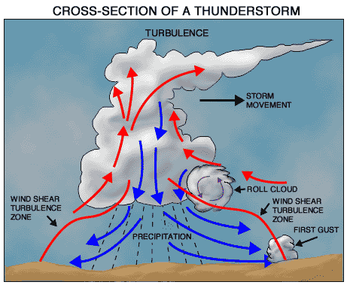
How are cloud structured?
Clients talk to clouds using web browsers or the web services standards
  But this only gets us to the outer “skin” of the cloud data center, not the interior
  Consider Amazon: it can host entire company web sites (like Target.com or Netflix.com), data (AC3), servers (EC2) and even user-provided virtual machines!
CS5412 Spring 2015 (Cloud Computing: Birman)

Slide 3


Big picture overview
Client requests are
handled in the “first
tier” by
  PHP or ASP pages
  Associated logic
These lightweight
services are fast
and very nimble
Much use of caching:
a sharded key-value
store in the “second tier”
1
1
1
1
1
1
2
2
2
2
2
1
2
Sharded key-value store
1
2
Index
1
2
DB

Slide 4
Many styles of system
Near the edge of the cloud focus is on vast numbers of clients and rapid response
Inside we find high volume services that operate in a pipelined manner, asynchronously
Deep inside the cloud we see a world of virtual computer clusters that are scheduled to share resources and on which applications like MapReduce (Hadoop) are very popular
CS5412 Spring 2015 (Cloud Computing: Birman)

Slide 5
Asynchronous pipeline model
Outside layer of the cloud
absorbs read accesses, but
updates are tricky
Popular model: Guess at the
update outcome and respond
using that, but send the “real”
update asynchronously to a
back-end server / database.
Later, correct inconsistencies
CS5412 Spring 2015 (Cloud Computing: Birman)

Slide 6
In the outer tiers replication is key
We need to replicate
  Processing: each client has what seems to be a private, dedicated server (for a little while)
  Data: as much as possible, that server has copies of the data it needs to respond to client requests without any delay at all
  Control information: the entire structure is managed in an agreed-upon way by a decentralized cloud management infrastructure
CS5412 Spring 2015 (Cloud Computing: Birman)

Slide 7
Shared key-value store?
The caching components running in tier two are
central to the responsiveness of tier-one services
  Basic idea is to always used cached data if at all possible, so the inner services (here, a database and a search index stored in a set of files) are shielded from “online” load
  We need to replicate data within our cache to spread loads and provide fault-tolerance
  But not everything needs to be “fully” replicated. Hence we often use “shards” with just a few replicas
CS5412 Spring 2015 (Cloud Computing: Birman)

Slide 8
Sharding used in many ways
The second tier could be any of a number of caching services:
  Memcached: a sharable in-memory key-value store
  Other kinds of DHTs that use key-value APIs
  Dynamo: A service created by Amazon as a scalable way to represent the shopping cart and similar data
  BigTable: A very elaborate key-value store created by Google and used not just in tier-two but throughout their “GooglePlex” for sharing information
Notion of sharding is cross-cutting
  Most of these systems replicate data to some degree
  Achieves high availability but also increases performance
CS5412 Spring 2015 (Cloud Computing: Birman)

Slide 9
Do we always need to shard data?
Imagine a tier-one service running on 100k nodes
  Can it ever make sense to replicate data on the entire set?
Yes, if some kinds of information might be so valuable that almost every external request touches it.
  Must think hard about patterns of data access and use
  Some information needs to be heavily replicated to offer blindingly fast access on vast numbers of nodes
  The principle is similar to the way Beehive operates.
    Even if we don’t make a dynamic decision about the level of replication required, the principle is similar
    We want the level of replication to match level of load and the degree to which the data is needed on the critical path
CS5412 Spring 2015 (Cloud Computing: Birman)

Slide 10
And it isn’t just about updates
Should also be thinking about patterns that arise when doing reads (“queries”)
  Some can just be performed by a single representative of a service
  But others might need the parallelism of having several (or even a huge number) of machines do parts of the work concurrently
The term sharding is used for data, but here we might talk about “parallel computation on a shard”
CS5412 Spring 2015 (Cloud Computing: Birman)

Slide 11

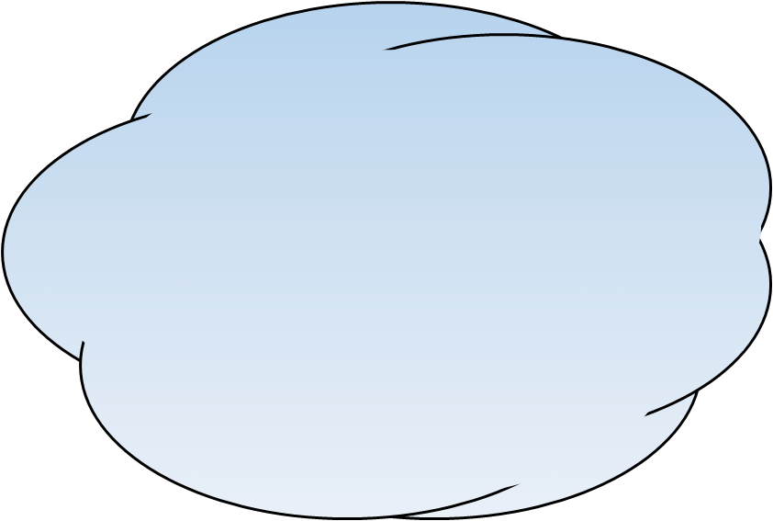
What does “critical path” mean?
Focus on delay until a client receives a reply
Critical path are actions that contribute to this delay
Update the monitoring and alarms
criteria for Mrs. Marsh as follows…
Service instance
Response delay seen by end-user would include Internet latencies
Service response delay
Confirmed
CS5412 Spring 2015 (Cloud Computing: Birman)

Slide 12
What if a request triggers updates?
If the updates are done “asynchronously” we might not experience much delay on the critical path
  Cloud systems often work this way
  Avoids waiting for slow services to process the updates but may force the tier-one service to “guess” the outcome
  For example, could optimistically apply update to value from a cache and just hope this was the right answer
Many cloud systems use these sorts of “tricks” to speed up response time
CS5412 Spring 2015 (Cloud Computing: Birman)

Slide 13
First-tier parallelism
Parallelism is vital to speeding up first-tier services
Key question:
  Request has reached some service instance X
  Will it be faster…
    … For X to just compute the response
    … Or for X to subdivide the work by asking subservices to do parts of the job?
Glimpse of an answer
  Werner Vogels, CTO at Amazon, commented in one talk that many Amazon pages have content from 50 or more parallel subservices that ran, in real-time, on your request!
CS5412 Spring 2015 (Cloud Computing: Birman)

Slide 14
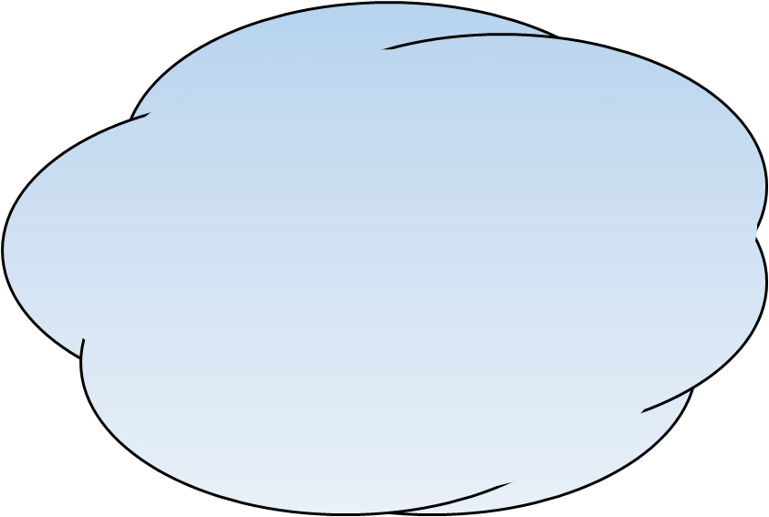
What does “critical path” mean?
In this example of a parallel read-only request, the critical path centers on the middle “subservice”
Update the monitoring and alarms
criteria for Mrs. Marsh as follows…
Service instance
Critical path
Response delay seen by end-user would include Internet latencies
Critical path
Service response delay
Confirmed
Critical path
CS5412 Spring 2015 (Cloud Computing: Birman)

Slide 15
With replicas we just load balance
Update the monitoring and alarms
criteria for Mrs. Marsh as follows…
Service instance
Response delay seen by end-user would include Internet latencies
Service response delay
Confirmed
CS5412 Spring 2015 (Cloud Computing: Birman)

Slide 16
But when we add updates….
Update the monitoring and alarms criteria for Mrs. Marsh as follows…
Execution timeline for an individual first-tier replica
A B C D
Soft-state first-tier service
Send
Response delay seen by end-user would also include Internet latencies not measured in our work
Send
Now the delay associated with waiting for the multicasts to finish could impact the critical path even in a single service
Send
Confirmed
CS5412 Spring 2015 (Cloud Computing: Birman)

Slide 17
What if we send updates without waiting?
Several issues now arise
  Are all the replicas applying updates in the same order?
    Might not matter unless the same data item is being changed
    But then clearly we do need some “agreement” on order
  What if the leader replies to the end user but then crashes and it turns out that the updates were lost in the network?
    Data center networks are surprisingly lossy at times
    Also, bursts of updates can queue up
Such issues result in inconsistency
CS5412 Spring 2015 (Cloud Computing: Birman)

Slide 18
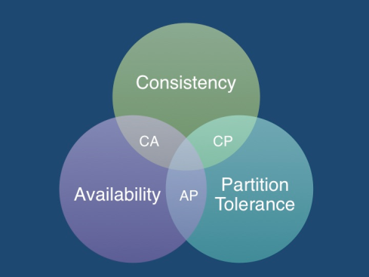
Eric Brewer’s CAP theorem
In a famous 2000 keynote talk at ACM PODC, Eric Brewer proposed that “you can have just two from Consistency, Availability and Partition Tolerance”
  He argues that data centers need very snappy response, hence availability is paramount
  And they should be responsive even if a transient fault makes it hard to reach some service. So they should use cached data to respond faster even if the cached entry can’t be validated and might be stale!
Conclusion: weaken consistency for faster response
CS5412 Spring 2015 (Cloud Computing: Birman)

Slide 19
CAP theorem
A proof of CAP was later introduced by MIT’s Seth Gilbert and Nancy Lynch
  Suppose a data center service is active in two parts of the country with a wide-area Internet link between them
  We temporarily cut the link (“partitioning” the network)
  And present the service with conflicting requests
The replicas can’t talk to each other so can’t sense the conflict
If they respond at this point, inconsistency arises
CS5412 Spring 2015 (Cloud Computing: Birman)

Slide 20
Is inconsistency a bad thing?
How much consistency is really needed in the first tier of the cloud?
  Think about YouTube videos. Would consistency be an issue here?
  What about the Amazon “number of units available” counters. Will people notice if those are a bit off?
Puzzle: can you come up with a general policy for knowing how much consistency a given thing needs?
CS5412 Spring 2015 (Cloud Computing: Birman)

Slide 21

THE WISDOM OF
THE SAGES
CS5412 Spring 2015 (Cloud Computing: Birman)

Slide 22


eBay’s Five Commandments
As described by Randy Shoup at LADIS 2008
Thou shalt…
  1. Partition Everything
  2. Use Asynchrony Everywhere
  3. Automate Everything
  4. Remember: Everything Fails
  5. Embrace Inconsistency
CS5412 Spring 2015 (Cloud Computing: Birman)

Slide 23

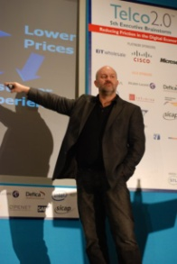
Vogels at the Helm
Werner Vogels is CTO at Amazon.com…
He was involved in building a new shopping cart service
  The old one used strong consistency for replicated data
  New version was build over a DHT, like Chord, and has weak consistency with eventual convergence
This weakens guarantees… but
  Speed matters more than correctness
CS5412 Spring 2015 (Cloud Computing: Birman)

Slide 24


James Hamilton’s advice
Key to scalability is decoupling,
loosest possible synchronization
Any synchronized mechanism is a risk
  His approach: create a committee
  Anyone who wants to deploy a highly consistent mechanism needs committee approval
…. They don’t meet very often
CS5412 Spring 2015 (Cloud Computing: Birman)

Slide 25

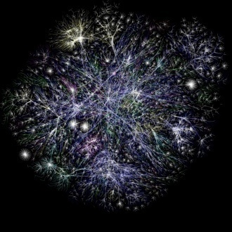
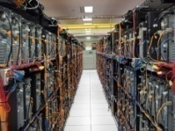



Consistency
Consistency technologies just don’t scale!
CS5412 Spring 2015 (Cloud Computing: Birman)

Slide 26

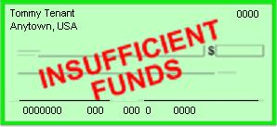
But inconsistency brings risks too!
My rent check bounced?
That can’t be right!
Inconsistency causes bugs
  Clients would never be able to
  trust servers… a free-for-all
Weak or “best effort” consistency?
  Strong security guarantees demand consistency
  Would you trust a medical electronic-health records system or a bank that used “weak consistency” for better scalability?
Jason Fane Properties 1150.00
Sept 2009 Tommy Tenant
CS5412 Spring 2015 (Cloud Computing: Birman)

Slide 27
Puzzle: Is CAP valid in the cloud?
Facts: data center networks don’t normally experience partitioning failures
  Wide-area links do fail
  But most services are designed to do updates in a single place and mirror read-only data at others
  So the CAP scenario used in the proof can’t arise
Brewer’s argument about not waiting for a slow service to respond does make sense
  Argues for using any single replica you can find
  But does this preclude that replica being consistent?
CS5412 Spring 2015 (Cloud Computing: Birman)

Slide 28
What does “consistency” mean?
We need to pin this basic issue down!
As used in CAP, consistency is about two things
  First, that updates to the same data item are applied in some agreed-upon order
  Second, that once an update is acknowledged to an external user, it won’t be forgotten
Not all systems need both properties
CS5412 Spring 2015 (Cloud Computing: Birman)

Slide 29
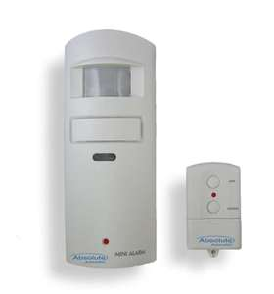











What properties are needed in remote medical care systems?
Motion sensor, fall-detector
Healthcare provider monitors large numbers of remote patients
Medication station tracks, dispenses pills
Integrated glucose monitor and Insulin pump receives instructions wirelessly
Cloud Infrastructure
Home healthcare application
CS5412 Spring 2015 (Cloud Computing: Birman)

Slide 30

Which matters more: fast response, or durability of the data being updated?
Mrs. Marsh has been dizzy. Her stomach is upset and she hasn’t been eating well, yet her blood sugars are high.
Let’s stop the oral diabetes medication and increase her insulin, but we’ll need to monitor closely for a week
Cloud Infrastructure
Patient Records DB
Need: Strong consistency and durability for data

Slide 31
What if we were doing online monitoring?
Update the monitoring and alarms criteria for Mrs. Marsh as follows…
Execution timeline for an individual first-tier replica
A B C D
Soft-state first-tier service
Response delay seen by end-user would also include Internet latencies
Send
Send
Local response delay
Send
Confirmed
flush
An online monitoring system might need 1ms response times.
It would value consistency, yet be less concerned with durability

Slide 32
Cloud services and their properties
Service | Properties it guarantees
Memcached | No special guarantees
Google’s GFS | File is current if locking is used
BigTable | Shared key-value store with many consistency properties
Dynamo | Amazon’s shopping cart: eventual consistency
Databases | Snapshot isolation with log-based mirroring (a fancy form of the ACID guarantees)
MapReduce | Uses a “functional” computing model within which offers very strong guarantees
Zookeeper | Yahoo! file system with sophisticated properties
PNUTS | Yahoo! database system, sharded data, spectrum of consistency options
Chubby | Locking service… very strong guarantees
CS5412 Spring 2015 (Cloud Computing: Birman)

Slide 33

Core problem?
Our challenge is a form of “role-driven” service in which the properties of the service are shaped by the way we plan to use it
  One application might have multiple such services in it, like the medical example, which has a monitoring service with real-time roles and a durable database.
  We don’t want to sweep important properties away, but we sometimes have to make tradeoffs
CS5412 Spring 2015 (Cloud Computing: Birman)

Slide 34
Where does this all lead us?
High assurance cloud computing is feasible!
  Experts already doing it in a plethora of services
  The main obstacle is that typical application developers tend to use one-size-fits-all packages with one-size-fits-all properties and guarantees.
As we develop better tools and migrate them to the cloud platforms developers use, options will improve
We’ll see that these really are solvable problems!
CS5412 Spring 2015 (Cloud Computing: Birman)

